Slide 1

Prediction of Slide Events for Horizontal Drill Operations
Daniel Serna
James Vasquez
Donald Markley – VP Drilling & Completions

Slide 2
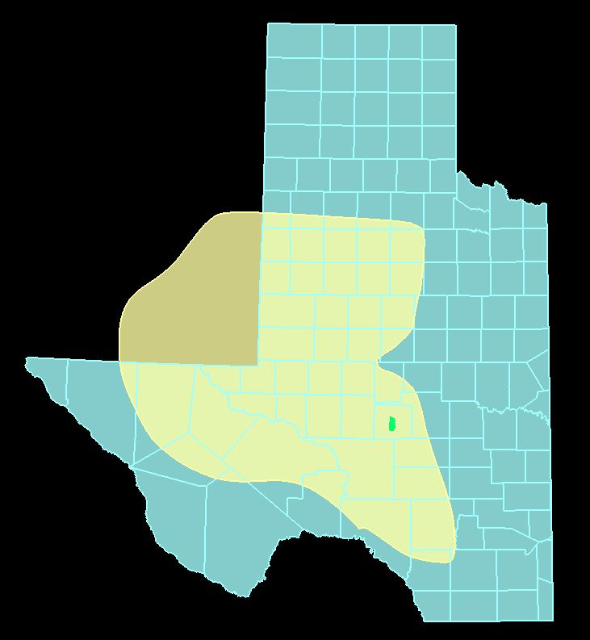
Permian Basin
Notes:
Talk about the size of the basin
86K square miles
If the basin was it’s own state it would be the 11th largest state in the US
Larger than 39 other states
IF you would add the bottom 10 states, Permian basin would still be larger

Slide 3
Why is drilling hard
Well density
Cost
Unknowns
Technical
Notes:
So many wells have already been drilled
Drilling cost are about 1.2 to 1.6 million dollars
Drilling through faults, rock types
Drilling underground is just hard

Slide 4
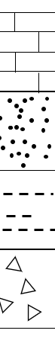
Vertical Drilling
Limestone
Sandstone
Shale
Basement Rock
Well path
Target Formation
Total Depth
Notes:
Traditional drilling
Multiple wells to get at the same formation
Basic rock types

Slide 5
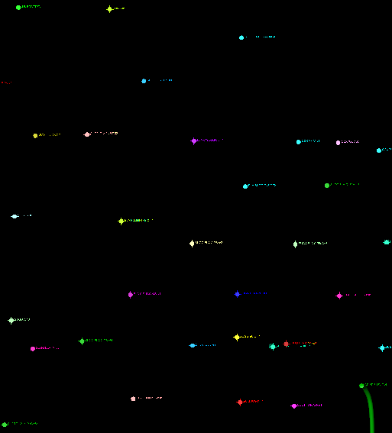

Vertical Drilling vs Horizontal Drilling
2 mile
2 mile
Notes:
Explain the birds eye view

Slide 6
Horizontal Drilling
Limestone
Sandstone
Shale
Basement Rock
Well path
Target Formation
Total Depth
Notes:
Horizontal well being the norm
Talk about the lengths 10 ft lateral
Less surface damage

Slide 7
Horizontal Drilling Sliding vs Rotating
Limestone
Sandstone
Shale
Basement Rock
Well path
Target Formation
Total Depth
Notes:
Talk about the rotation and why its important
What happens when we slide
Why do we want more rotation
Ever possible to eliminate slidding

Slide 8

Problem Statement
Identify the classification of sliding vs rotating
Predict the future slide events
Notes:
What happens when we slide
Why do we want more rotation
Ever possible to eliminate slidding

Slide 9
Problem Statement
Identify the classification of sliding vs rotating
Predict the future slide events

Slide 10

Data
Notes:
Data come in real time
Data given on 21 wells
3 million rows of data
Stored in SQL Server
500+ features

Slide 11
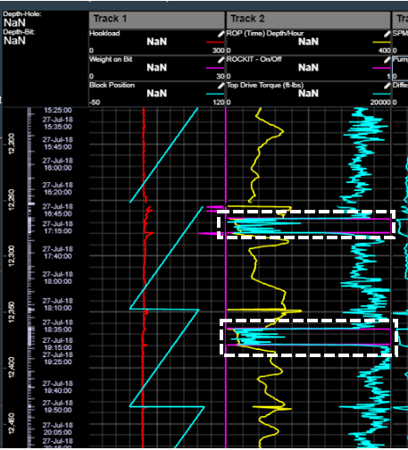
Data
Slide Events
Torque
Rate of Penetration
Block Position
Label
Notes:
MyWells
User looks at this while drill operations happening
User is in office and can view

Slide 12
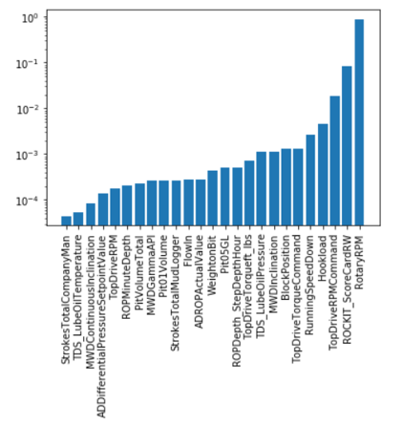
Data Cleansing Feature Selection
Notes:
Remember the 500+ features
First round of EDA removed unnecessary columns
Left with over 100+ columns
Still too many features and unimportant features coming up

Slide 13
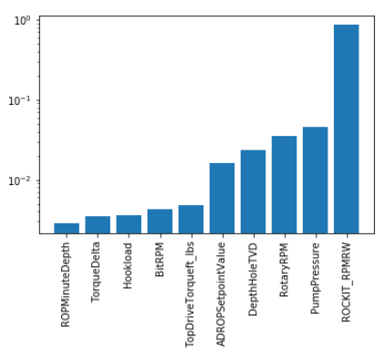
Data Cleansing Feature Selection
Notes:
A grid search applied
Working with BU removed additional features and features we cannot do anything about
Wanted to keep actionable features

Slide 14
Problem Statement
Identify the classification of sliding vs rotating
Predict the future slide events
Notes:
Why are we doing this
Optimize drilling operations
Longer drill time operations are the more chance something goes wrong
Cost of drill operations

Slide 15
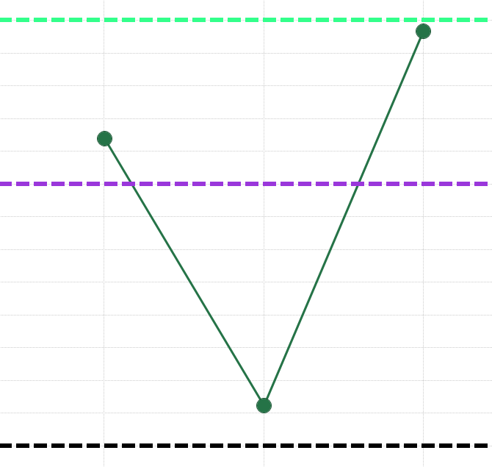
Models
.99 Accuracy
.985 Accuracy
Accuracy
RF
.977 Accuracy
LR
SVM
Notes:
Talk about the 3 models we built
Why these 3 models – Classification
Talk about prediction was on the next point and not future points

Slide 16
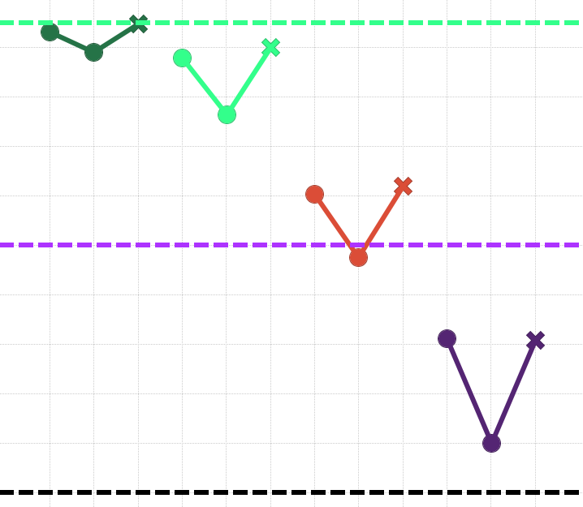


Models Resampled
.99 Accuracy
Raw
1 Min
5 Min
10 Min
SVM
.90 Accuracy
Accuracy
Resample Data
.80 Accuracy
Notes:
Why did we want to re-sample
Model ran for several hours with raw data
Re-sampled data took a fraction of the time
Dropped data rown count from 729K to 120K rows

Slide 17
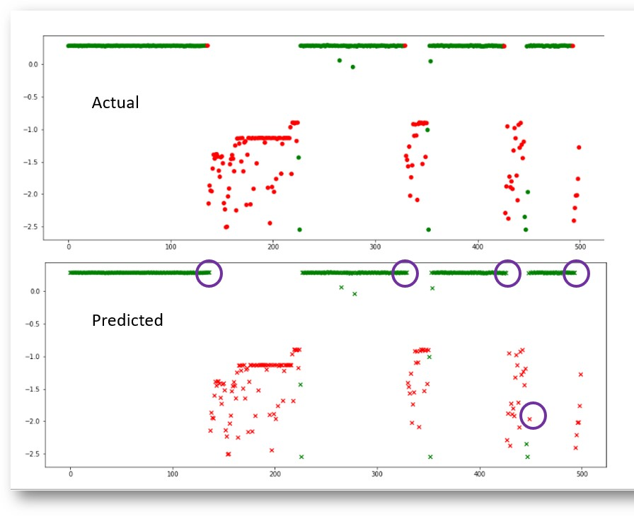

Results
Rotating
Sliding
Notes:
Explain the colors

Slide 18
Results
Rotating
Sliding
Notes:
Why misclassification are the beginning and end
Is this ok, it is because we are concerned about the are in the slidding

Slide 19
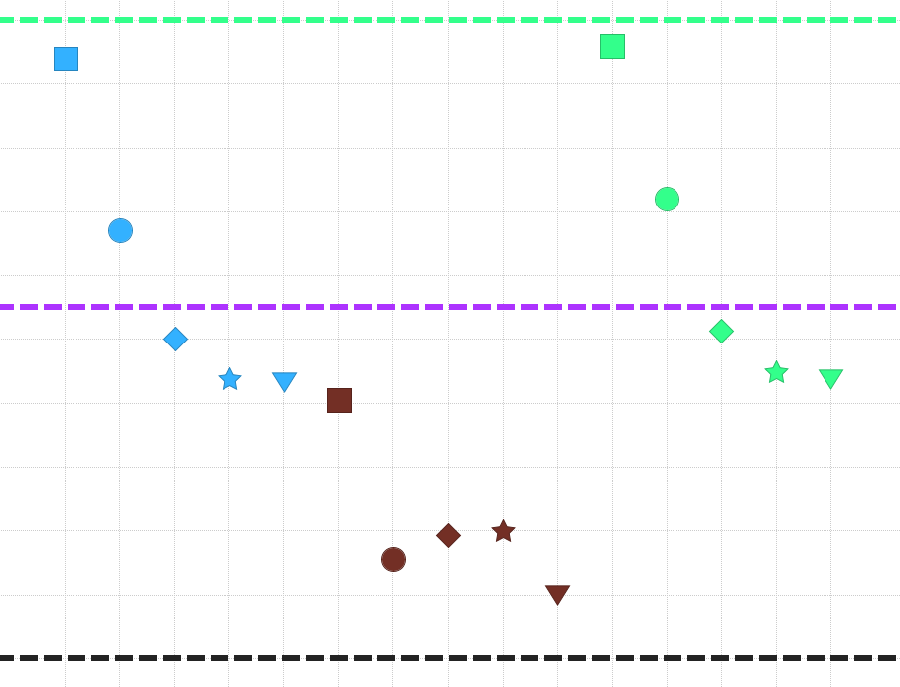
Future Predictions
.85 Accuracy
Jump Ahead Minutes
10
15
20
25
30
.75 Accuracy
Accuracy
.65 Accuracy
LR
RF
SVM

Slide 20
Future Predictions
.85 Accuracy
Jump Ahead Minutes
10
15
20
25
30
.75 Accuracy
Accuracy
.65 Accuracy
LR
RF
SVM

Slide 21


Future Work
Notes:
How do we make our jump ahead more accurate
Neural networks, deep learning

Slide 22


Future Work
Productionize
Notes:
Still working on images
Basically just saying now that we have this how do we get it into live system

Slide 23
Future Work

Slide 24
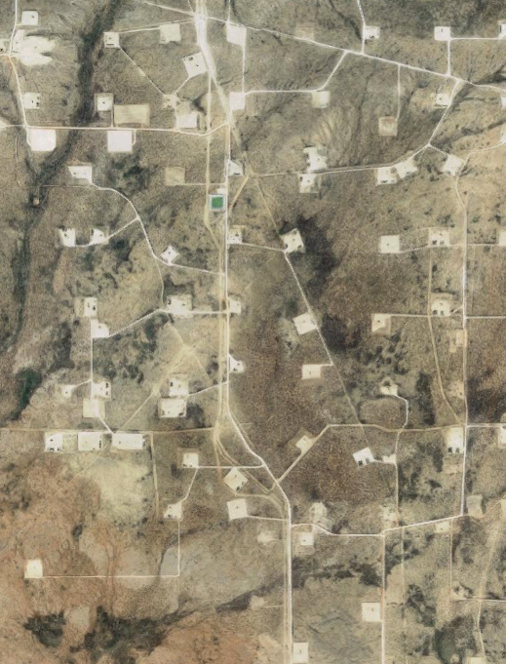
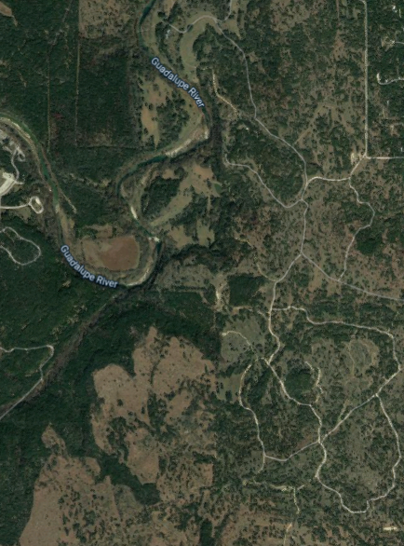
Ethics
3 mi²
Notes:
Showing the same area
Left = West Texas
Right = Hill Country Texas

Slide 25
Ethics
3 mi²
Notes:
2018 Stats Crude Oil breakdown for US
https://www.eia.gov/energyexplained/oil-and-petroleum-products/use-of-oil.php
69% used for transportation
25% used for industrial
3% used for residential
2% used commercial
1 % used for electric power

Slide 26
Summary
SVM model produces 98% accuracy on test data
Jumping ahead predictions are lower at 83%

Slide 27
Summary
SVM model produces 98% accuracy on test data
Jumping ahead predictions are lower at 83%

Slide 28
END

